Slide 1
HireAC
YOUR HOW TO GUIDE

Slide 2
HireAC Guide Sections
Getting Started with HireAC
Cooperative Education Module in HireAC
Changing Preferred Name in HireAC
Downloading the Co-op Work Permit Confirmation Letter
Co-op Documents Page in HireAC
Co-op Job Postings Page in HireAC
Setting up Job Alerts in HireAC
Co-op Interviews Page in HireAC
Co-op Job Offers in HireAC
Co-op Work-term record in HireAC
Booking a Peer Review meeting in HireAC
Events And Workshops Module in HireAC
Career & Employment Module in HireAC

Slide 3
1. Getting Started with HireAC
Overview of HireAC

Slide 4

How to use HireAC
Go to HireAC: https://hireac.algonquincollege.com/home.htm
Click on Students/Student Login
This will redirect you to the single sign on login page. Use your AC student credentials to log into HireAC.

Slide 5
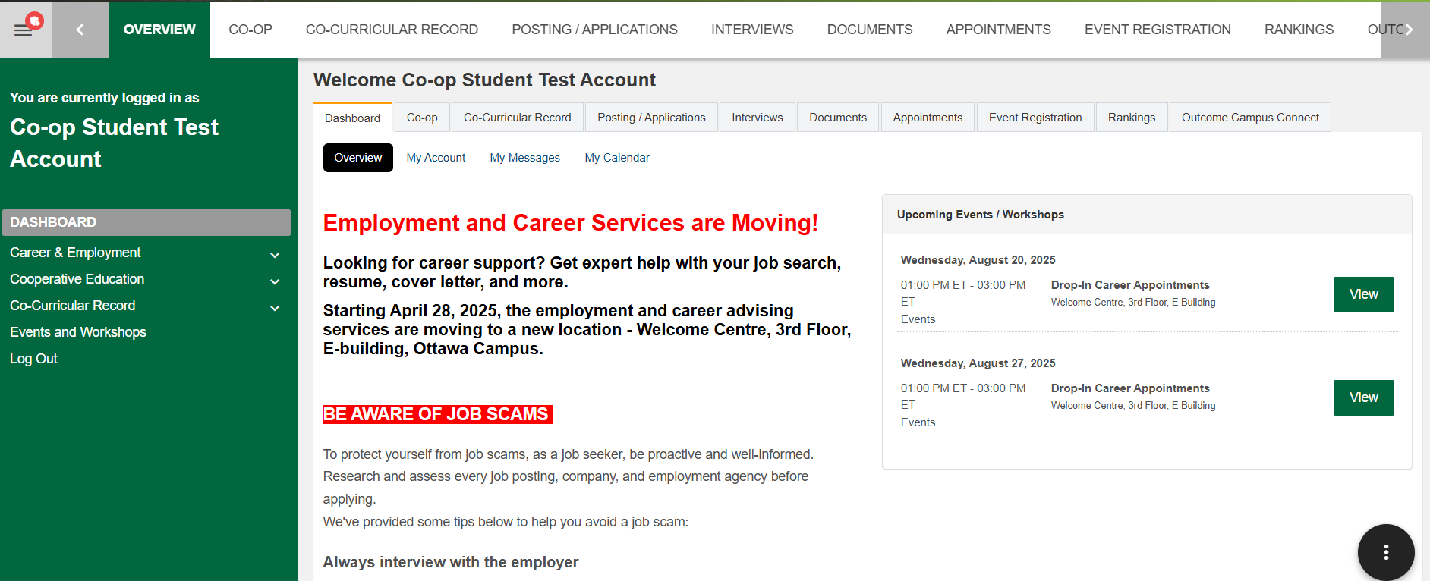
HireAC Introduction
HireAC is an exclusive online job board for Algonquin College students and graduates!
Whether you’re looking for employment opportunities, co-op placements, or career development events, you can find everything in one place.
There are four main modules in HireAC: Career & Employment, Cooperative Education, Co-Curricular Record and Events and Workshops.
The Co-op and Caree Centre will post any key announcements related to HireAC on the Dashboard that you see when you first log in.

Slide 6
HireAC – Four Main Modules
Career & Employment
Browse current full-time, part-time, co-op, and summer job openings across different industries, and set up alerts to stay updated about new opportunities related to your field.
Access on-campus CSEP (College Student Employment Program) positions that are part of Algonquin’s Work Study Program.
Cooperative Education
This module is available to all eligible Co-op students. This is the module that you will be using during the Co-op Job Search term to view and apply to Co-op jobs for your program of study, upload your documents, schedule interviews.
If you secure a Co-op job, you will also continue to use this module during the work-term to manage your Co-op work term assignments that are submitted through HireAC.

Slide 7
HireAC – Four Main Modules
Events and Workshops
Find and register for the upcoming job fairs, employer information sessions, networking events, and career workshops.
Co-Curricular record
This module is used to track, record, customize and print a copy of your Co-Curricular Record that includes volunteer activities on and off campus.

